Slide 1
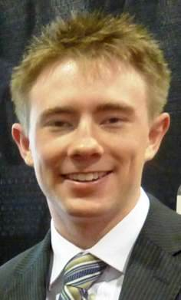
VectorVest Canada Online Forum Saturday, February 6, 2016
Welcome! Our meeting will start promptly at 11:00 AM EST
Jamin Heller, Moderator
Stan Heller, Presenter

Slide 2
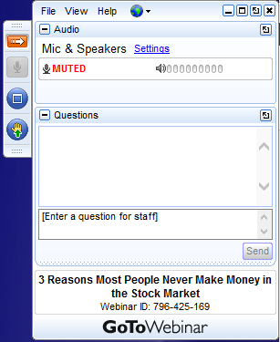
Questions? Comments.

Slide 3
Welcome
Purpose for these monthly Forums:
Further your knowledge of the VectorVest System.
To share current ideas and strategies for making money and protecting wealth.
To create opportunities to interact and share ideas with other members of our VectorVest community.
To promote the meetings and activities of our VectorVest Canada User Groups.
To provide a forum for VectorVest Investors who do not live near a User Group Community.

Slide 4
Agenda
11:00 Welcome and Purpose of Meeting (5 min.)
11:05 The 7-Minute Market Forecast (20 min.)
Colour Guard Review
Market Timing Graph
Market Climate
11:20 User Group News
Meetings This Month (5 min.)
Industry Group Analysis - Healthcare (Marijuana)
11:40 **Member Presentations** (30 min.)
Relative Safety Driver – A New Search and Trading Strategy Focusing on RS, by Rick Rodgers, Calgary Member (20 Min)
How to Use Custom Field Builder to Customize Your Candlestick Searches, by Graham Jones, Calgary Member (10 Min)
12:10 Trending Stocks Spotlight (15 min.)
How to Prepare for a Breakout in an Oversold Market, by Stan Heller, Consultant, VectorVest Canada
How to Set-up Your Trades in a Volatile Market Using Jamin Heller’s Trade Analysis and Risk Management Calculator
ADJOURN – 12:30 ET

Slide 5
The 7-Minute Market Forecast
Review:
Home Page and Views - Insights and Strategy – CA and US
Analysis of the Market Timing Graph
Market Climate
This week’s Special Presentation

Slide 6
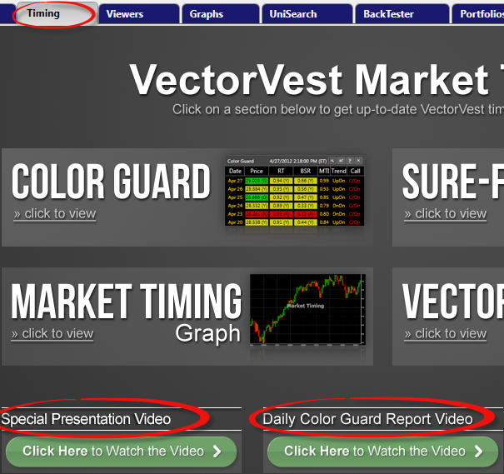
The 7-Minute Market Forecast
Keeping On Top of the Market
Read The Views – US and CA
Listen to the Daily Color Guard Reports – US Database
Study the Home Page
Study the Derby Leaders for insights into market direction.
Review:
Home Page and Views - Insights and Strategy – CA and US
Analysis of the Market Timing Graph
Market Climate
This week’s Special Presentation

Slide 7
Join Us: Tuesday, SOTW Q&A Webcast

Slide 8
User Group News
Meetings This Month (5 min.)

Slide 9
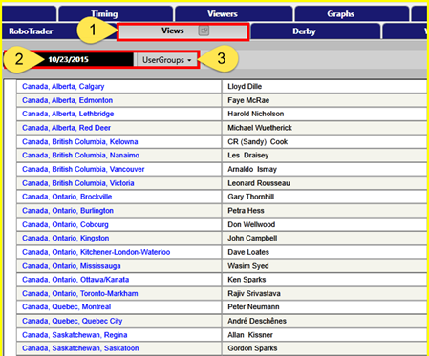
User Group Meeting Notices
For more information including agendas, maps and driving directions, go to:
VectorVest Views
Any Friday
User Group Section

Slide 10
Comments from Victoria and Nanaimo about the Successful Investing – Level II Workshop
“I must say that I was extremely impressed with the Intermediate Seminar in Nanaimo. The content was such that I think it was of great interest to possible new subscribers and we “old timers” alike.” – Joan
“Although I am a longer-term subscriber to VV (6-8 years), I still find useful kernels of info and advice from your workshops. This new format is very good and I particularly liked the MTI info in the first session and also the portfolio management/risk management portion at the end. This was a "level II" presentation, but I believe that it was very useful to newbies too.” – Gerry
“Thanks again Stan for the all the great information yesterday.” – Hans
“I just like to thank you for a informative and well presented Investing workshop in Nanaimo. I think this workshop will be well received across Canada. You present the material with lightness and humor that makes the workshop fun. A course well put together! My favored topic: Precision Trading using VV Graphs. So much information there. Awesome.” – Werner
“This is to thank you for the presentation in Victoria yesterday. I better understood the process. I came away with a clearer understanding how the development of my YEARLY FINANCIAL PLAN should be created.” – James
Register at: www.vectorvest.ca

Slide 11
User Group News
Industry Group Analysis Report
Healthcare (Marijuana) has been added to CA Database

Slide 12
Agenda
11:40 **Member Presentations** (30 min.)
Relative Safety Driver – A New Search and Trading Strategy Focusing on RS, by Rick Rodgers, Calgary Member (20 Min)

Slide 13
Relative Safety Driver (RSD)
New Search and Trading System
for the
Canadian Market
Presented to the VectorVest
Canadian Online Forum
February 6, 2016

Slide 14
Background
Purpose: share results of a new search and trading system that utilizes the power of RS with a sprinkling of VST, EY and a Ratchet Stop
Investment Style: designed for the Prudent Investor
Key Goals (in order of priority)
Excellent rates of return
Non-Threatening maximum drawdowns
Works in both up and down markets without shorting or contra ETFs
No loss in any year
Limited trades per year
Liquid stocks
Exclude stock Sectors I typically don’t buy
How Developed
First developed in 4Q 2014 – inspired by a Stan Heller search using RS
Based on VV teachings with lots of trial and error plus a little luck

Slide 15
Primary Test Periods
9/19/14
12/31/15
Start of Run
End of Run
6/27/12
3
1
1/2/15
3/31/11
9/11/13
2

Slide 16
Performance Results
RSD
DATE | ARR | MAXD | VVC ARR
3/31/11 to 6/27/12 | 15 | 7 | -15
9/11/13 to 9/19/14 | 26 | 5 | 17
1/2/15 to 12/31/15 | 19 | 11 | -8
2008-2015 | 25 | 19 | 1
TRADING SYSTEM | 2013-2015 (ARR/MAXD) | 2015 (ARR/MAXD)
RSD | 32/11 | 19/11
STAR SEARCH | 1/26 | -12/21
HIGH FLIERS | 2/23 | -11/16
JAKES/HINDEN* | 45/9 | 6/9
SAFE&SOUND/ CRASH LANDERS* | 28/11 | 12/9
PALE BLUE CHIP | 12/6 | -1/6
BEST NEW HIGHS & DIV. | 6/41 | -3/9
1
2
3
2008-2015
No loss in 2008; 5% loss in 2009; 1% loss in 2010
Trades/month ~ 1.7
* Start at CUP call

Slide 17
RSD Equity Curve 2013-2015 (Ratchet Stop)
ARR = 32% MAXD = 11% Winners = 57% Trades = 55 (1.5 /month)
Stocks Selected by Search: Top Gainers - ACQ, MG, NFI. Top Losers - CCA, IFP

Slide 18
RSD Equity Curve 2013-2015 (Stop –> R=S)
ARR = 36% MAXD = 10% Winners = 71% Trades = 25 (0.7 /month)
Stocks Selected by Search: Top Gainers - ACQ, MG, NFI. Top Losers - RME, GSY

Slide 19
Search and Trading System
Search (RSD)
RS>=1.1
EY > 0
Price >= 2$
Average Volume >= 20000
RS>= 4 weeks ago
RS>=13 weeks ago
RS>=52 weeks ago
Sector <> Mining, REITs, Investment Trusts
RT Trending Higher - 1 week
Sort = VST*EY descending
Trading System
Search = RSD
Portfolio Size = 100000$
Commission 9.95$/trade
Execute next days open
Execute daily pricing mode
Confirmed call: Buy long CUP; No action CDN
Stop = Ratchet Stop (EOD) - Stop of R=S also works well
5 positions
Replace closed positions
Open all positions at once
Close if opened in different situation
Invest average portfolio value
Odd lots
Limit repurchase to 31 days
Don't buy stocks that violate stop criteria
Max % of stocks average volume = 3%

Slide 20
Thank you
Questions

Slide 21
Agenda
How to Use Custom Field Builder to Customize Your Candlestick Searches, by Graham Jones, Calgary User Group Member
(10 Min)

Slide 22
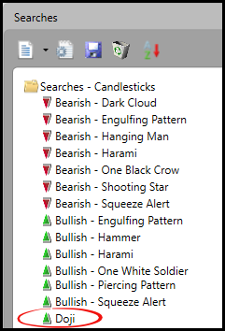
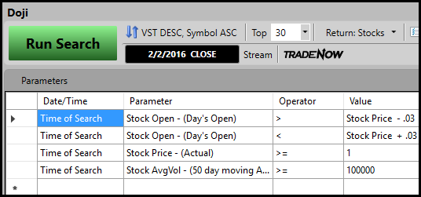
VectorVest Doji – Searches Candlesticks Folder
VectorVest recently introduced a series of candlestick searches including the Doji as shown below and in the next slide. This presentation will show how we can modify VectorVest’s search to deliver more accurate and consistent results.

Slide 23
VectorVest’s Doji in Searches Candlesticks Folder
Mathematically, parameter 1 is looking for a stock in which the current price has dropped by less than 3 cents from the opening price. Parameter 2 is looking to make sure that the stock price has risen less than 3 cents over the opening price. In practice this means that a Doji will be found if the current price is within 2 cents of the opening price, because it seems that, in the search mode, the prices are to the nearest cent.
This works well for a stock in the $30 range as many stocks are. However, a $1.00 stock, which is the lowest price found in this search, could have a range from 2.5 cents (in practice the range is 2 cents) and still be found as a Doji, although it really is not a Doji. For high price stocks e.g. Alphabet, a 3.0 cent range above or below the opening price would definitely be a Doji, but would be very rare. I ran this search with the 3rd line being changed to look for stocks over $500. In fact, finding these Doji’s with the search provided is so rare that I needed to automate with the backtester to find examples.

Slide 24
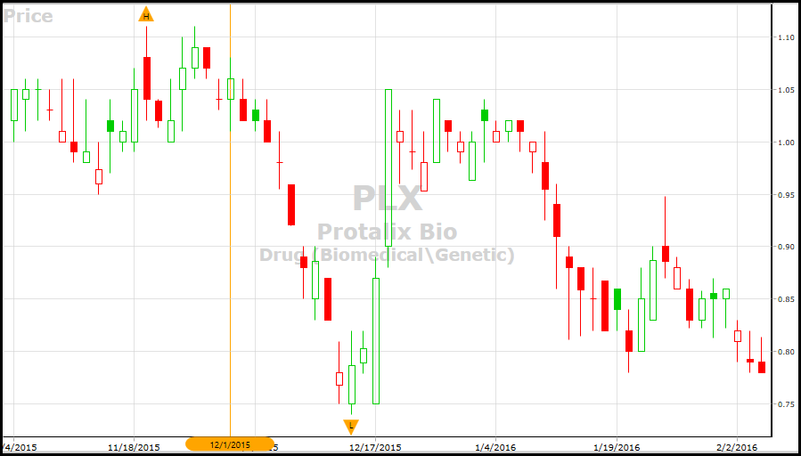
PLX Found by VectorVest Doji Search
Here is an example of a low priced stock returned on December 1, 2015 by VectorVest’s Doji search.
It is a .02 cent difference between the open and the close, (marginally less than 2%).
It is not a Doji.

Slide 25
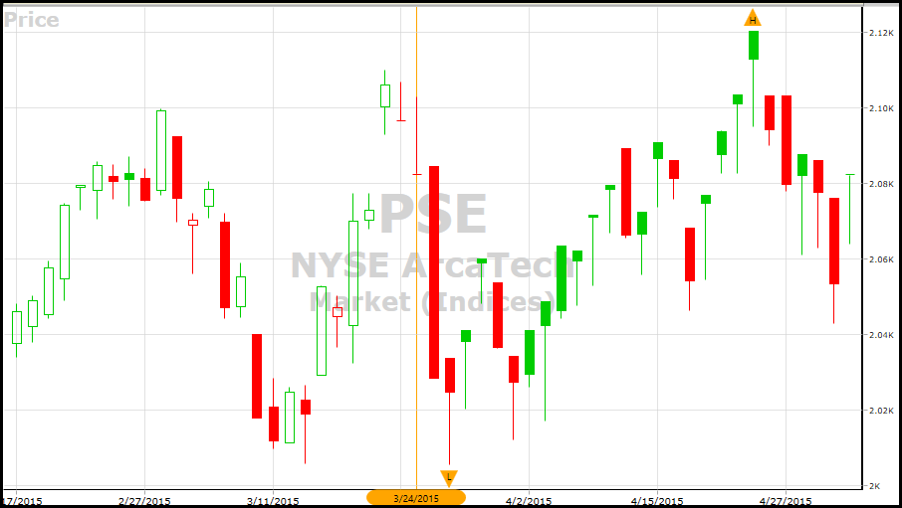
PSE Index Found by VectorVest Doji Search
Here is an example of a high-priced index I found accidently. VectorVest’s Doji search correctly found it on March 23, 2015, but not the following day March 24, (shown by the blue arrow) which obviously is really a Doji too.

Slide 26
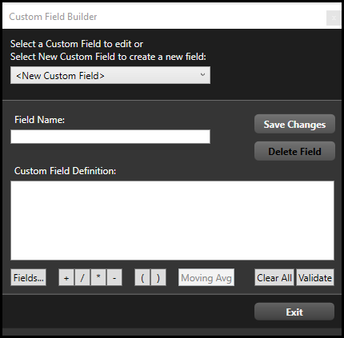
How We Can Modify VectorVest’s Doji Search
To make an improved Doji search, we will use percentage increase and decrease of 0.1% instead of using fixed amounts of .03 cents up or down.
While in the UniSearch function, go to the Tools tab.
Select Custom Field Builder and you will see the screen as shown.
Type a suitable field name. It is easier to remember and use it if your description is similar to the mathematical function.

Slide 27
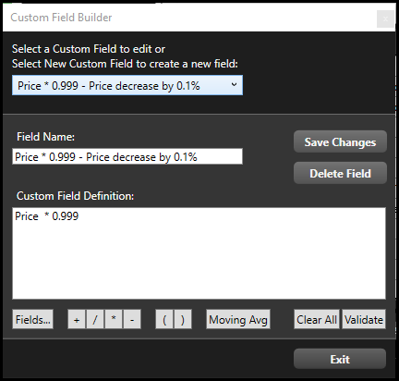
Price Decrease by 0.1% - Custom Field Builder
Step 1: Price decrease by 0.1%
To make an improved Doji search, we will use percentage increase and decrease of 0.1% instead of using fixed amounts of .03 cents up or down.
(GO TO PROGRAM TO DEMONSTRATE)

Slide 28
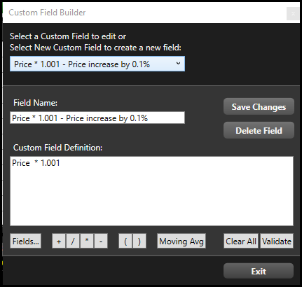
Price Increase by 0.1% - Custom Field Builder
Step 2: Price Increase by 0.1%
Type a suitable field name. It is easier to remember and use it if your description is similar to the mathematical function.

Slide 29
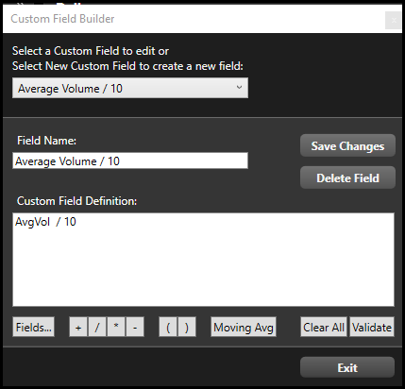
A New Volume Custom Field
Step 3: The VectorVest search may find a Doji on a day when the volume of a stock trade is zero.
To avoid that, I added the Custom Field as shown.

Slide 30
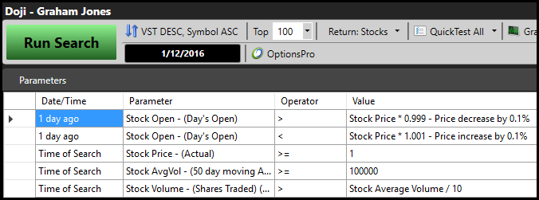
A New Volume Custom Field
Step 4: Put these parameters together to make an improved Doji search.
When you are adding a Custom Field in UniSearch, you need to click your mouse:
In the Value section,
Click on Stock
Click on My Custom Fields
Choose the particular field that you require.

Slide 31
Using a Dragonfly Doji to Signify a Trend Change
Because a Doji is supposed to signify a change of trend, and should also be checked that there is follow through the next day, you might want to try Green Light Buyer as the Timing Signal, something like an EMA crossover, or Stochastic signal, that conditions are right for a change of trend, and you could make sure that the previous trend was in the opposite direction.
Since I avoid short positions, I will give the following as an example that you could tinker with until backtesting proved it possibly viable.

Slide 32
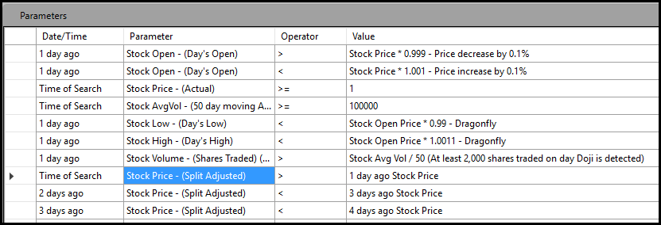
Finding a Dragonfly Doji on a Trend Change
The first four parameters are the ones you saw above, except that the search is being done after the following day’s opening to make sure that there is follow through by using the parameter on the eighth line. (Blue Shading).
The fifth and sixth parameters are to find a dragonfly doji, because a dragonfly is supposed to be even more bullish than the regular doji. You can simply delete those lines if you wish.
The ninth and tenth parameters are to make sure that the stock was in a short downtrend before the doji occurred.

Slide 33
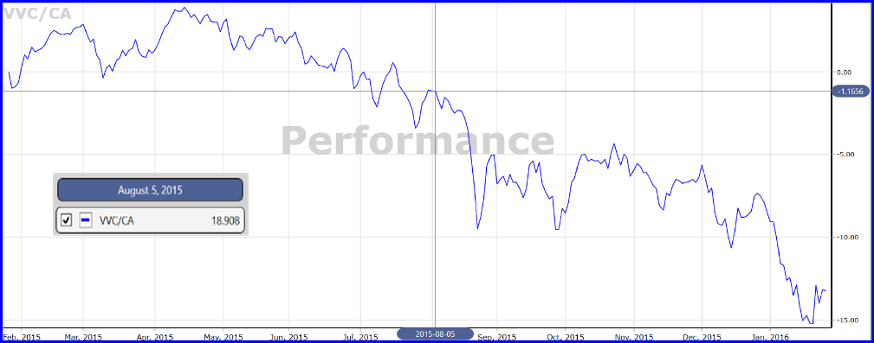
Performance Graph VVC/CA Index
Click on Graphs tab to go to VectorVest Graphs function.
From the drop down menu, you can choose Performance Graph.
Alternatively, with any Stock graph open, choose Performance Graph from the drop down menu to open a Performance Graph comparing the stock to its industry Group.

Slide 34
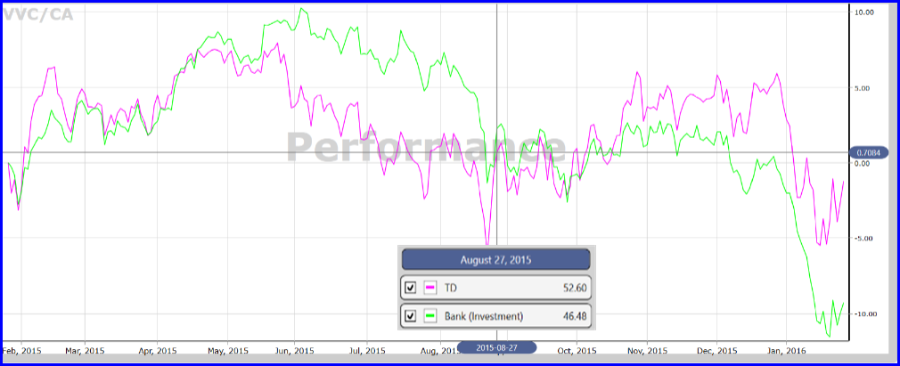
Performance Graph TD vs. Industry Group
Here is a Performance Graph of TD compared to its Industry Group – Bank (Investment).

Slide 35
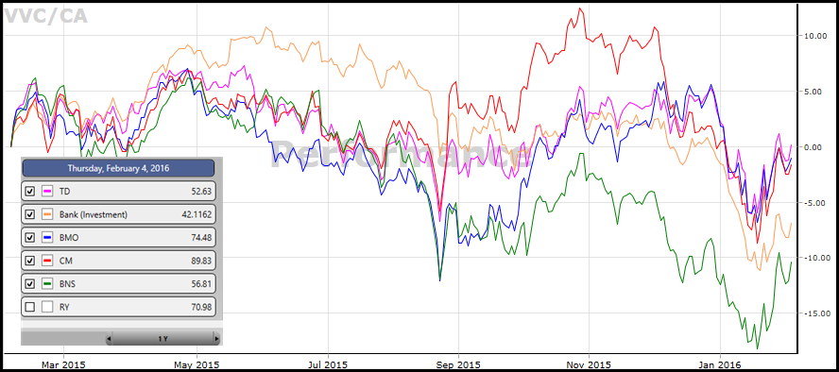
Performance Graph TD vs. Industry Group
You can then add other stocks to the graph for comparison as shown. I found that BMO and RY were too close to the overall bank performance for a clear picture, but each one can be turned on and off by clicking the box next to the stock name.
Note: You can save this Graph layout including stocks and colour schemes.

Slide 36
Trending Stocks Spotlight
Trending Stocks Spotlight (15 min.)
How to Prepare for a Breakout in an Oversold Market, by Stan Heller, Consultant, VectorVest Canada
How to Set-up Your Trades in a Volatile Market Using Jamin Heller’s Trade Analysis and Risk Management Calculator

Slide 37
Steps to Prepare for Breakout in Oversold Market
On MTI graph, look for MTI to fall below 0.60 and Stochastics to fall below 20.
Open Views tab and check Derby Winners for Searches with highest 1-Day percent price gains. Buy signal is generated when the majority of winners are Bullish and includes one or more Bottom-Fishing Strategies.
Run the top one or two bottom-fishing searches and place your top candidates in a WatchList.
If you can be at your computer the next day, place your order to buy the top 3-5 stocks that are moving up in the first 30 minutes. If you can’t be at your computer, place a Buy on Stop Limit order to buy starting at the next day’s open if the stock moves a few cents above the last close.
Unless you’re buying Long Term Winners, start to take profits or minimize losses when you hit your targets and for sure when Stochastics %K crosses above 80.

Slide 38
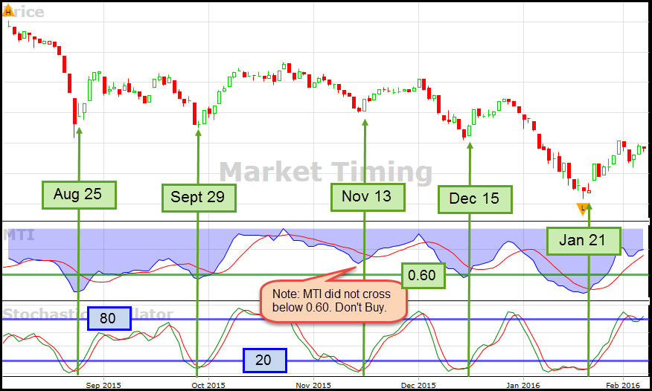
Examples from Recent Market Turns
Aug 25:
Blyar’s Bottoms – 42.39%
TSX SmallCap/RT – 25.70%
Jailbreak/CA – 30.09
Sept 30 to Oct 9:
Odd Fellows Long – 22.13%
Silber’s Singles – 19.92%
Jailbreak/CA – 48.48% (not in Top 5 Derby)
Nov 13 to Dec 1: (MTI did not fall below 0.60. Notice gains are smaller):
TSX Comp/RT – 9.88%
Pirates long – 12.34
Dec 15 to Dec 30:
Silber’s Singles – 8.32%
Jailbreak/CA – 35%
Jan 21 to Jan 29:
TSX Comp/RT – 23.98% S&P
TSX S&P MidCap/RT – 28%

Slide 39
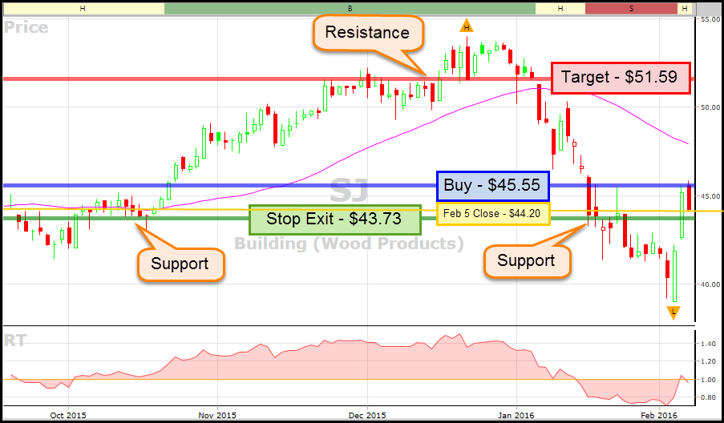
How to Set-Up Trades in a Volatile Market

Slide 40
How to Set-Up Trades in a Volatile Market

Slide 41
Open Discussion
Q&A

Slide 42
Guidance
The Months Ahead!
Request for March Presentations.
What’s working for you?
Care to share with our group?

Slide 43
Next Meeting
Thanks for attending!
Comments, Questions, Stock Ideas and What’s Working for You:
E-mail: stan.heller@vectorvest.ca
Let’s share you methods and ideas at our next Forum!
Next Meeting: February 6th @ 11:00 AM ET
Views/UserGroups/Canada Online User Group Forum

